Slide 1
Central limit theorem and confidence intervals
GEOG4300 /6300: Intro to data science
Prof. Jerry Shannon

Slide 2
This week
Z/t scores
Central limit theorem
Confidence intervals
Sampling

Slide 3
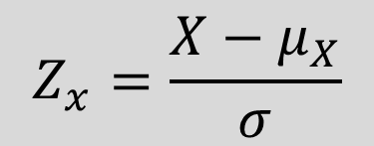
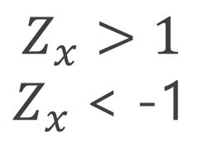
Z (and t) scores
How many standard deviations is an observation from the mean?
These can also be called standardized anomalies.
$$Z_{x}>1$$
${ Z}_{x}$< -1

Slide 4
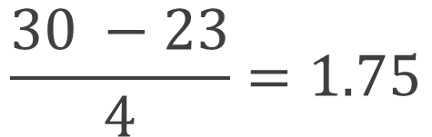
Z (and t) scores in practice
How many standard deviations is an observation from the mean?
For a variable with a mean of 23 and a s.d. of 4, the z-score for 30 would be:
$$\frac{30 −23}{4}=1.75$$
What value would produce a z-score of negative 2?

Slide 5
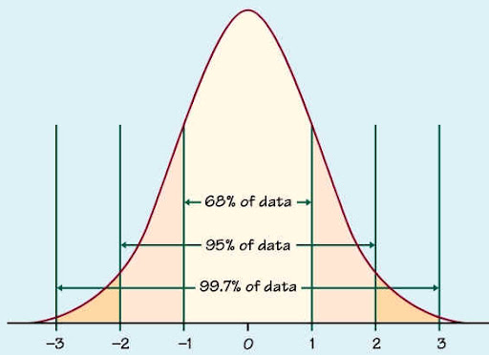
Z (and t) scores: Why do they matter?
They provide an easy way to compare data from different distributions (e.g. daytime and nighttime temperatures)
In a normal distribution, we can identify what percentage of observations fall within given range of Z scores.
Z scores of -1 to 1: 68% of observations
Z score of -1.75 to 1.75: 90% of observations
Z score of -1.96 to 1.96: 95% of observations

Slide 6
Data challenge!
Pick a variable from our county census dataset. Transform its values to z-scores in Excel. You’ll need to:
Calculate the mean and standard deviation for all observations
Subtract the mean and divide by standard deviation for all observations
How many counties are above 2? How many below -2? In what states/regions are these located?

Slide 7
The central limit theorem
What’s the relationship between the mean of the sample population and the actual population?

Slide 8
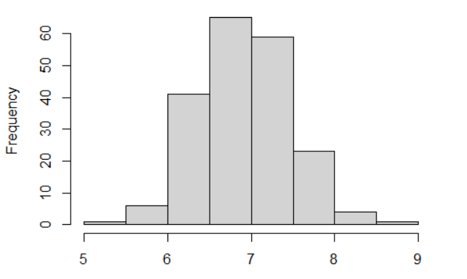

Central limit theorem
The distribution of sample means is normally distributed and centers around the population mean.
The actual mean is here somewhere!

Slide 9

Statistics is MAGIC
We will roll our dice 10 times. For ~95% of us, the mean value of those rolls will be between 5.5 and 8.5.
For the whole class, the mean of all the dice rolls will be between 6.5 and 7.5.

Slide 10

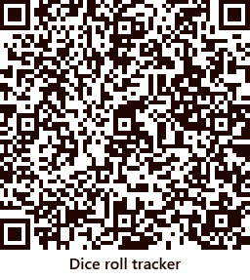
Let’s roll!
Roll your dice 10 times. Put the results on this page:

Slide 11

Did our prediction come true?
For ~95% of us, the mean value of those rolls will be between 5.5 and 8.5.
For the whole class, the mean of all the dice rolls will be between 6.5 and 7.5.

Slide 12
Identifying our terms
Samples: Each individual set of 10 dice rolls
Sample mean distribution: The mean values for each sample of 10 dice rolls
Standard error: The standard deviation of the sample mean distribution
Population: All possible means for of 10 dice rolls in the universe

Slide 13
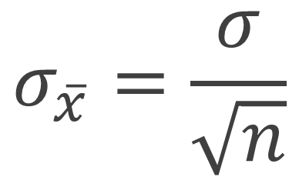
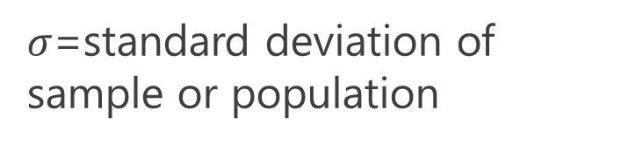
Standard error
$$σ_{\overline{x}}=\frac{σ}{\sqrt{n}}$$
How many sample means fit within 1 standard error of the mean? Within 2 standard errors?
$σ$=standard deviation of sample or population

Slide 14
Standard error for dice rolling
$$σ_{\overline{x}}=\frac{σ}{\sqrt{n}}$$
The mean of rolling two dice is 7
The standard deviation of rolling two dice is 2.42.
What’s the standard error for 10 dice rolls?
What’s the standard error for all our dice rolls?
$σ$=standard deviation of sample or population

Slide 15
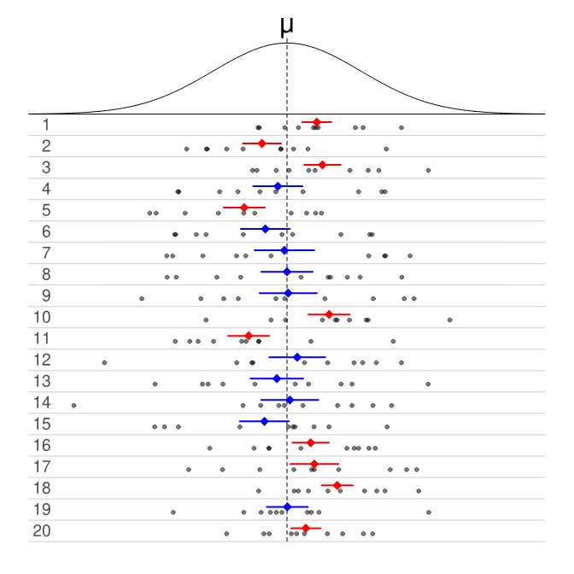
Confidence intervals
Predicts the range that will include the ACTUAL mean

Slide 16

Confidence intervals
Three ingredients for a confidence interval:
Sample mean
Standard error
Z-score for the confidence interval
Margin of error = z-score * the standard error
Subtract and add this MOE to the sample mean
What’s the confidence interval for each of your three dice roll samples? How many include the actual mean of 7?
$$σ_{\overline{x}}=\frac{σ}{\sqrt{n}}$$

Slide 17
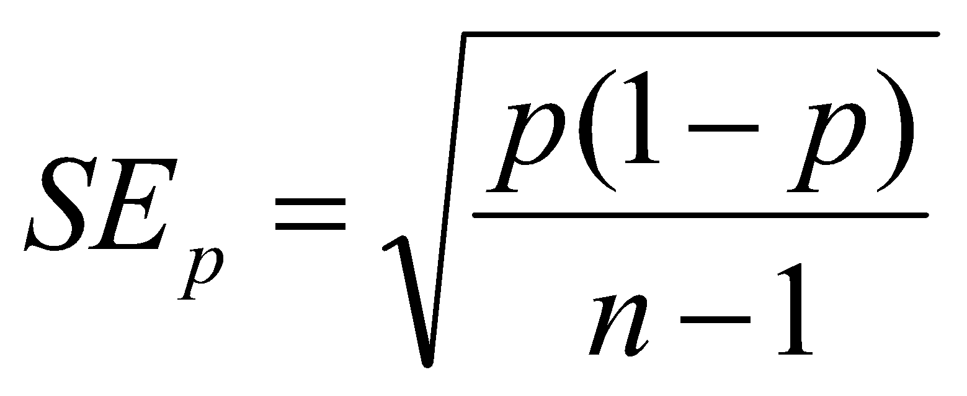
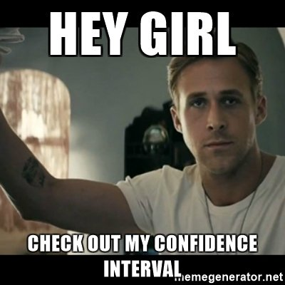
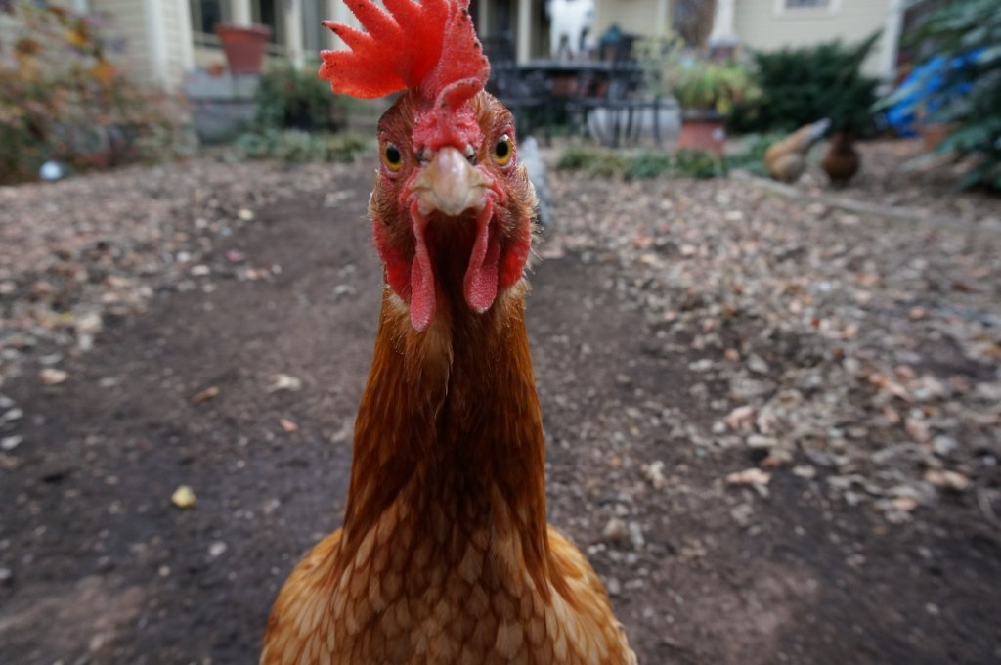
Confidence intervals for proportions
You asked 50 households in Athens if they keep chickens on their property. Three said they did. Create a confidence interval for the proportion of chicken owning households in the city.

